Slide 1



Touch
Typing
Class V
lab 8

Slide 2

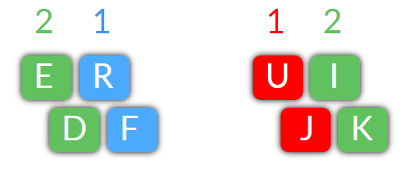
Finger Placement
set your finger on home keys and E R with left hand and U I with right hand

Slide 3
Practise
jude jude dud dud dude dude rude rude due due rudder rudder
fur fur fir fir fire fire fired fired ride ride fried fried rider rider
kid kid did did die die died died dried dried ride ride drier drier

Slide 4


